Slide 1
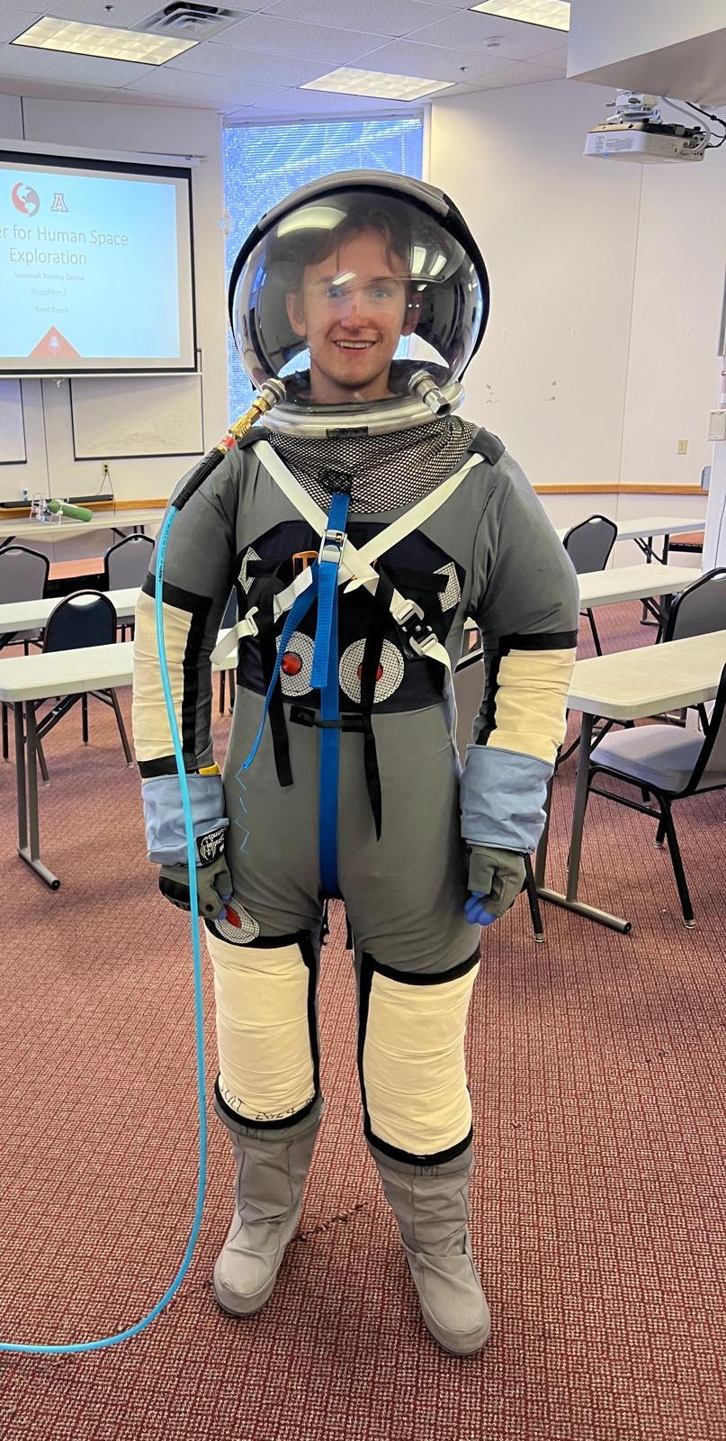



Development of a Low-Cost High Altitude Manned Balloon Capsule
Sean Young - Senior, Aerospace Engineering
Mentor: Trent Tresch - Director, University of Arizona Center for Human Space Exploration
Arizona NASA Space Grant Statewide Student Research Symposium
April 19, 2025

Slide 2
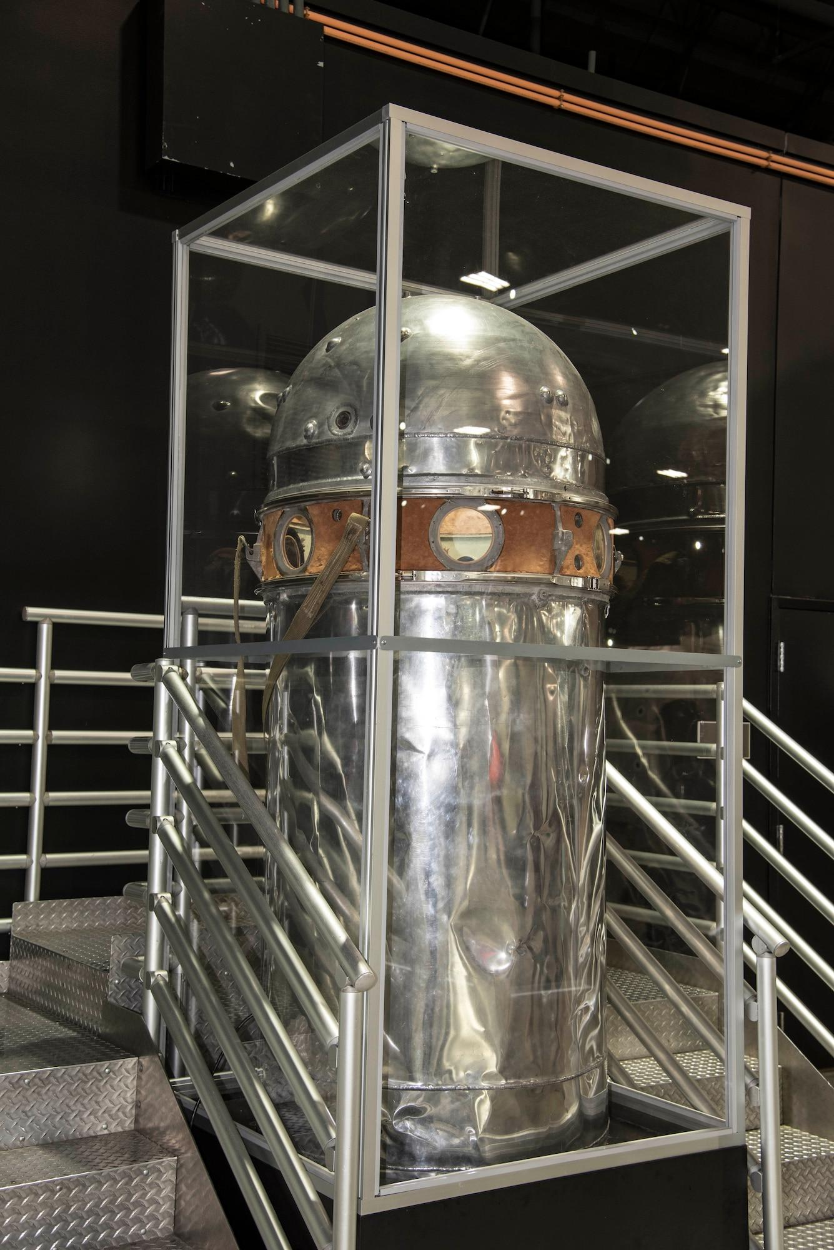
Problem Statement
The stratosphere (6-31 miles) is one of the least explored regions on Earth.
How can we change that?
Drones
Low Earth Satellites
High Altitude Planes
All of these methods have significant drawbacks.
Easiest, most reliable method is using human pilots.
Lots of flight tests occurred in the 50s-60s, but not much since then.
Project Manhigh Gondola - Air Force Museum
Notes:
how can balloons fill the holes that the others leave?
Weather research
Ozone layer research
Launch Platform
Medical research, etc

Slide 3
Objectives
Capsule capable of carrying two adult human occupants and remaining pressurized to ~1 standard atmosphere.
Associated gear, radios, safety equipment, etc.
Light enough to be carried by a medium sized gas balloon.
500-600 pounds without occupants.
Cost effective (full system < $10,000).
Small and maneuverable enough to be managed on the ground with a small crew.
Contains dials, instruments, controls for flight.
Built from simple, cheap, mass produced materials.

Slide 4
Analysis Performed
Evaluated historical pressurized balloon gondolas.
Analyzed various materials:
Chromoly
Steel
Aluminum
Wood
Fabric
Performed calculations on strength models when pressurized and during flight.
Planned tests to evaluate pressure capabilities and flight performance.
Notes:
cylinder/ spheres because of the beneficial stress situation

Slide 5
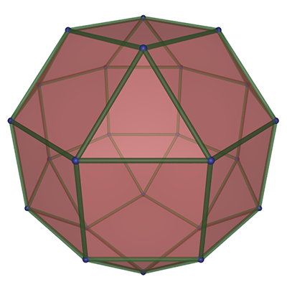
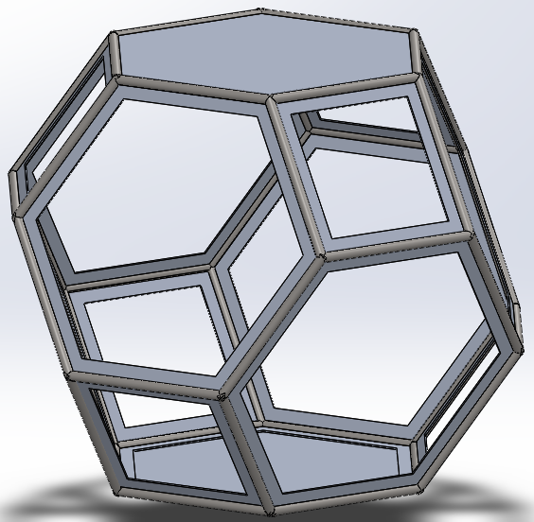
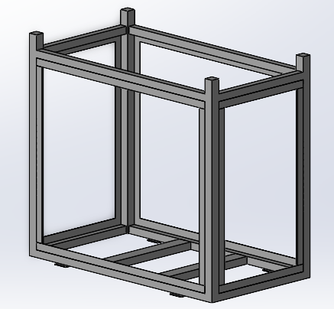
Shape Evolution
Notes:
Started with circle tubing, flanges. Truncated octohedron had a lot of lost space and was a little outside our sizing/budget.
Cubic cupola (rhombicuboctahedron) was the next logical evolution, but is very complicated, lots of welds and not a lot of great internal space.
Rectangular design is the first iteration of the cubic cupola shape, only pressurized component of the design, will evolve.

Slide 6
Results
Still ongoing!
After significant delays, pressure vessel is finally being built.
Asking for more funding to iterate on the design - finish the cubic cupola shape.
Plans are in work to perform pressure testing at the UofA vacuum chamber.
Also discussing with the Army to use the Willcox Playa for flight tests.
Notes:
delays of the vacuum chamber

Slide 7
Interpretations
Build cost is low enough to meet the goals we set.
If fabric panels work, the total systems weight allows for even larger crafts to be built with the same balloon size.
Future space programs could use capsules like this for training/research.
Aspirations of long-term habitation in stratosphere, performing ongoing experiments.
Future iterations will focus on manufacturability and lowering weight.

Slide 8
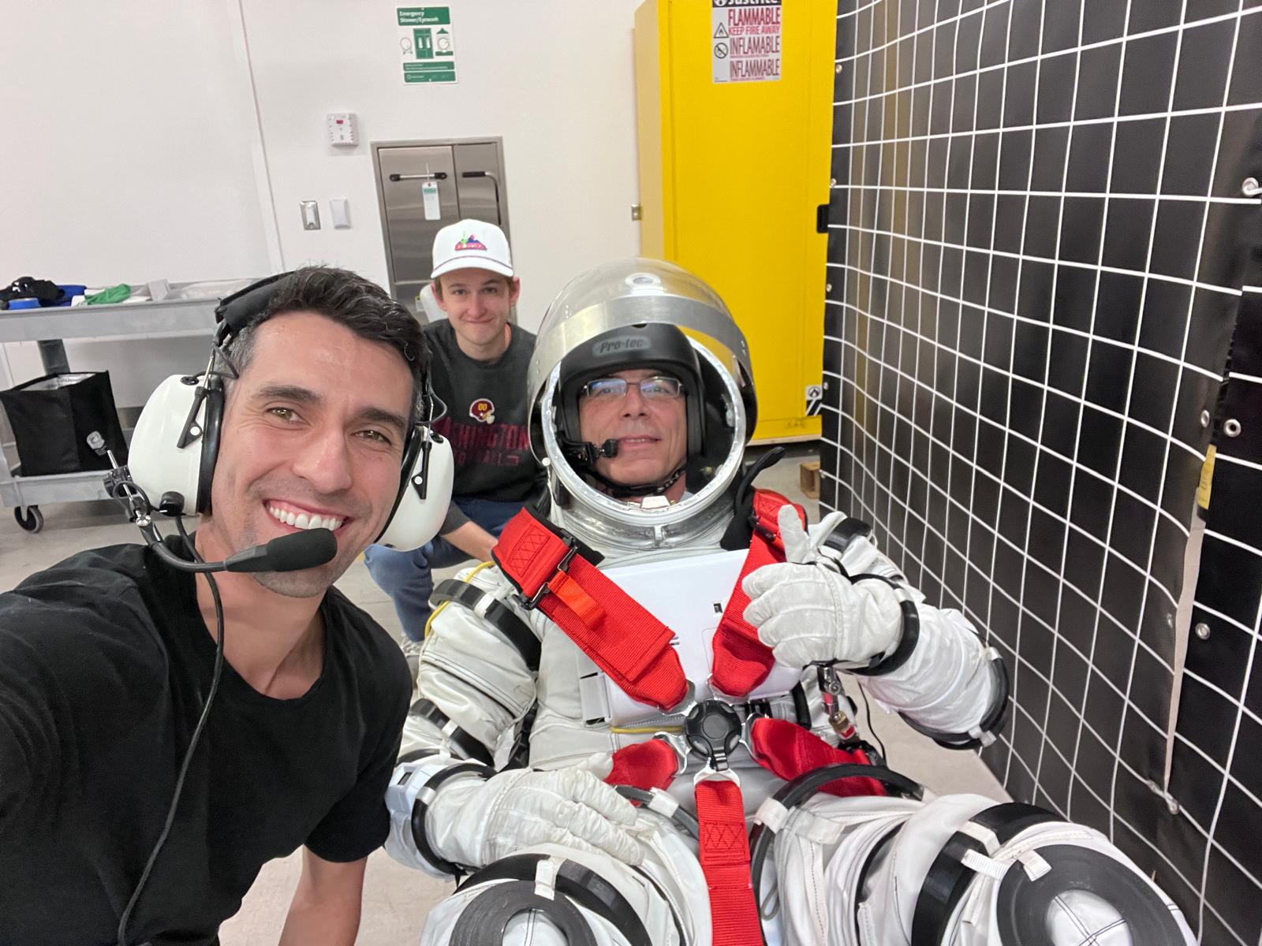
Thank You!

